Slide 1




RFID based Library Management System
Mentored By :
Dr.Anitha Kumari K
Associate Professor
Department of IT
PSG College of Technology

Slide 2

Introduction
The idea of the project is to replace the existing Bar code readers with RFID technology in a library. The idea of moving from conventional Bar Code system to RFID based system has many advantages. All such advantages and features will be discussed in the upcoming slides.

Slide 3

RFID Cards for everyone
Every student will be given an RFID Card to get and return the books.
Objective
Return counter machine
A return counter for books can be setup so that the books can be returned by the students by themselves.
The objective of this project is to develop a Library Management System which will function far more efficient than the conventional library management system.
RFID Cards for Books
Once RFID cards are placed in Books, a quick survey can be taken for the whole library in minutes.
Online Portal
An online portal is hosted where all the students can check the status of all the books that must be returned.

Slide 4






Implementation
A quick glance on the implemented features
LOGIN
RFID SETUP
WEBSITE
01
02
03
Users and Librarians can login and check the current status of the books
An RFID reader is setup for reading the RFID data.
A website is created with many features
BORROW AND RETURN
QUICK SURVEY
05
04
Librarians can take a quick survey of the entire books in the library in a matter of few minutes
Users can borrow and return the book using the same website

Slide 5
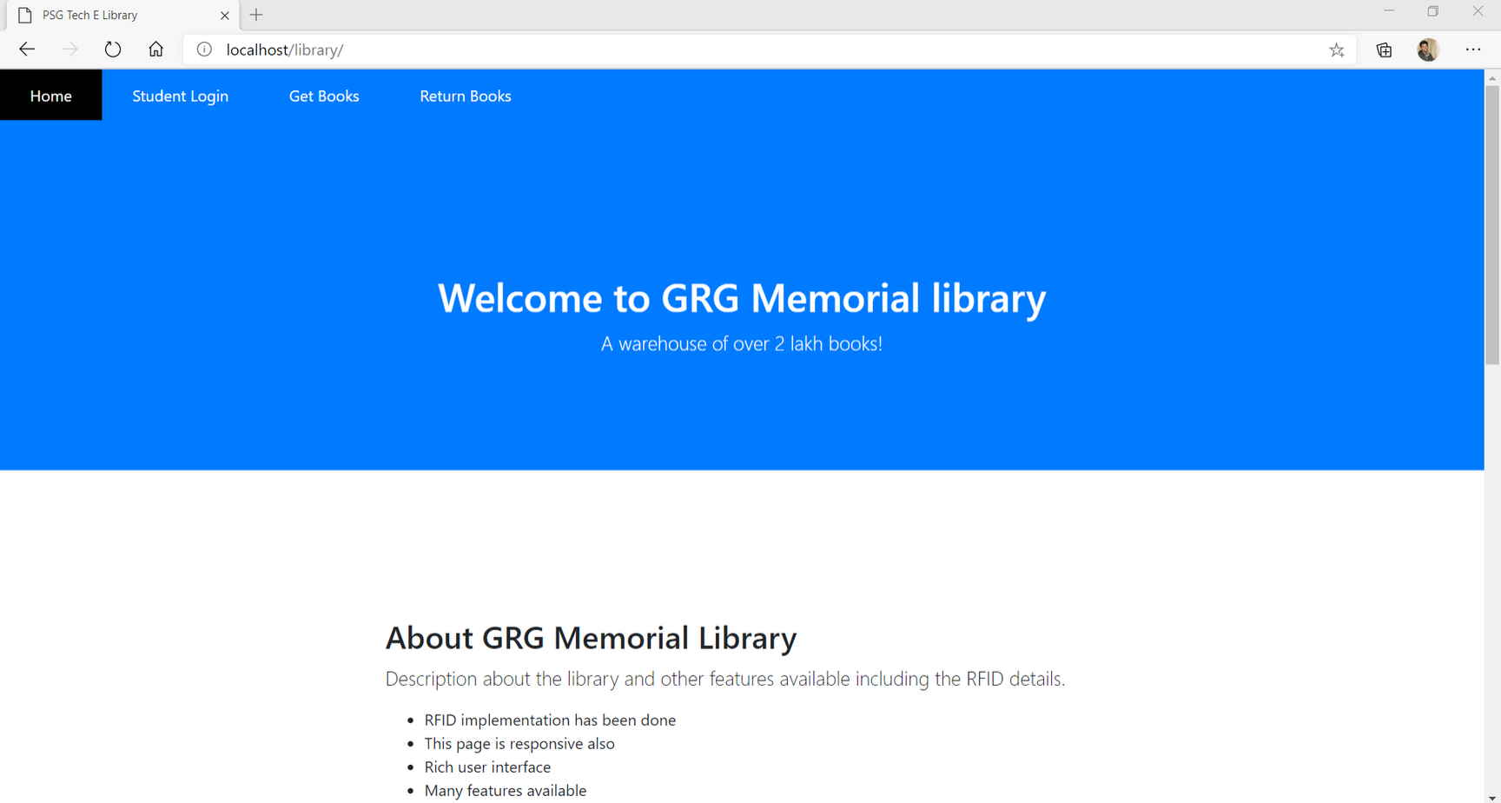
Screenshots

Slide 6
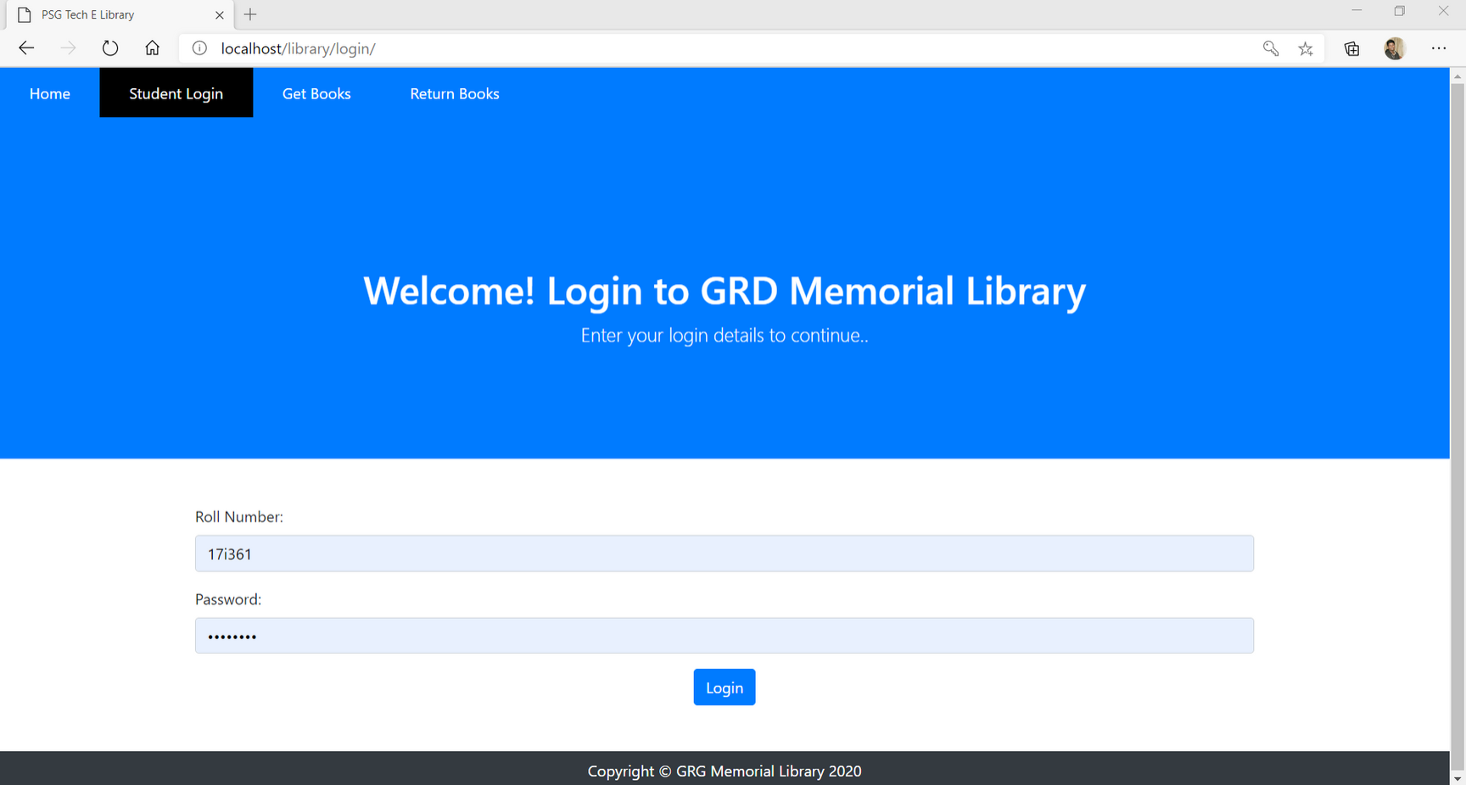
Screenshots

Slide 7

Reduced work for Librarians
Outcome of
Research
Every year, all librarians work for a whole month to take a survey of all the books that are available in the library. But, RFID implementation can give those results in a single day.
Tracing Books
Tracing the available books are made much easier since, a RFID gun can detect a particular book within minutes in the entire library.
Self return stalls
For returning the books that are borrowed, there is no human required to monitor the activity. Hence, a return stall can be set up to return the books and it can be collected by the librarians at the end of the day.

Slide 8

Expenditure
RFID Reader
An RFID Reader was bought for Rs.510 for reading the data in RFID cards
RFID Cards
RFID Cards was bought along with the RFID reader
Stall setup and RFID Gun
Due to the COVID-19 Virus outbreak, we could not purchase the
setup for a stall and RFID Gun

Slide 9

Bills Submission
RFID Reader and Cards Bills
Bills are uploaded in this link:
https://drive.google.com/open?
id=1U2s1MXusLln0_ISKGSDoecZA09cfuOQD
RFID Reader and Cards : 450 INR
Transfer Charge : 60 INR
Total cost incurred : 510 INR

